Slide 1
Chicago Energy Usage
-Projecting energy usage shifts in 2020

Slide 2
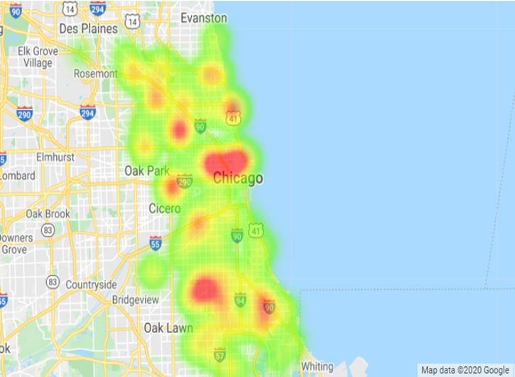
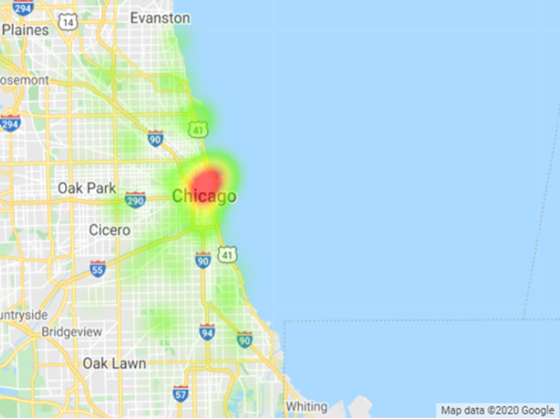
Electricity Usage – 2010
Residential Use
27% of total electricity used in Chicago
Single Family homes accounted for 57% of residential use
Commercial Use
46% of total electricity used in Chicago
The Loop accounted for 25% of commercial use

Slide 3
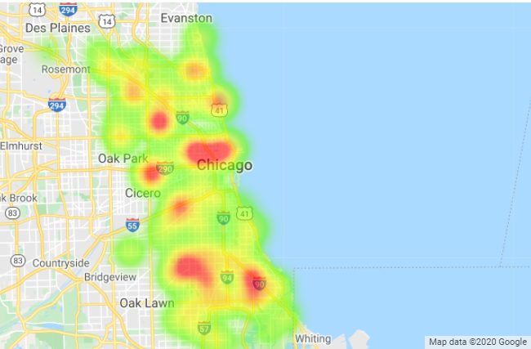
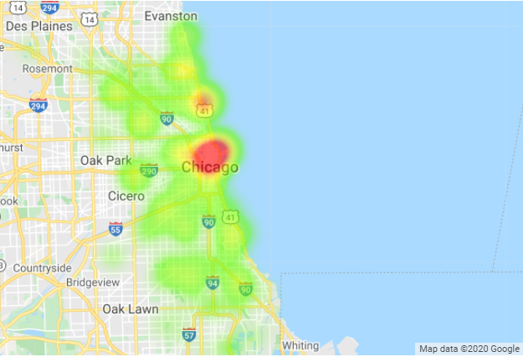
Gas Usage – 2010
Residential Use
53% of total natural gas used in Chicago
Single Family homes accounted for 52% of residential gas use
Commercial Use
30% of total natural gas used in Chicago
The Loop accounted for 10% of commercial gas use

Slide 4
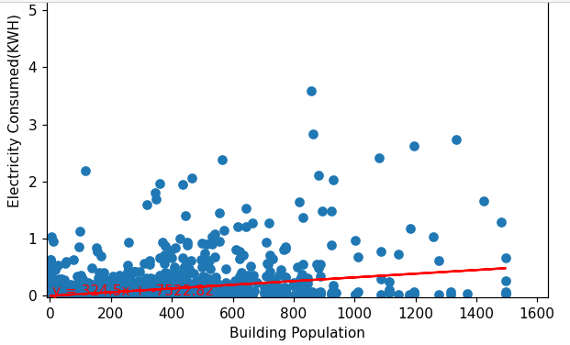
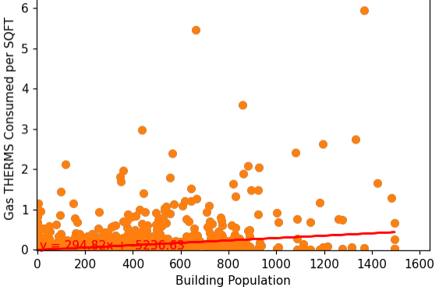
Key Stats – 2010
Building population increase is about 324 KW electricity a year across all building types
The r-squared value is: 0.1342853598783616
Building population increase is about 294 THERMS a year across all building types
The r-squared is: 0.12900909046920275

Slide 5
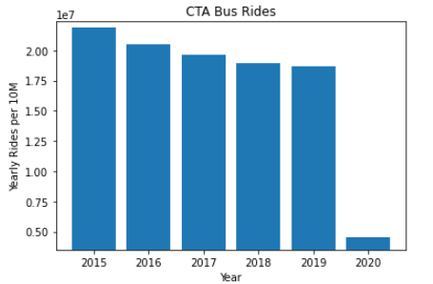
Key Stats
CTA Bus rides per year averaged 20M from 2015 to 2019
2020 is on pace to only have about 7M ~ 65% decrease
This translates to savings of about

Slide 6
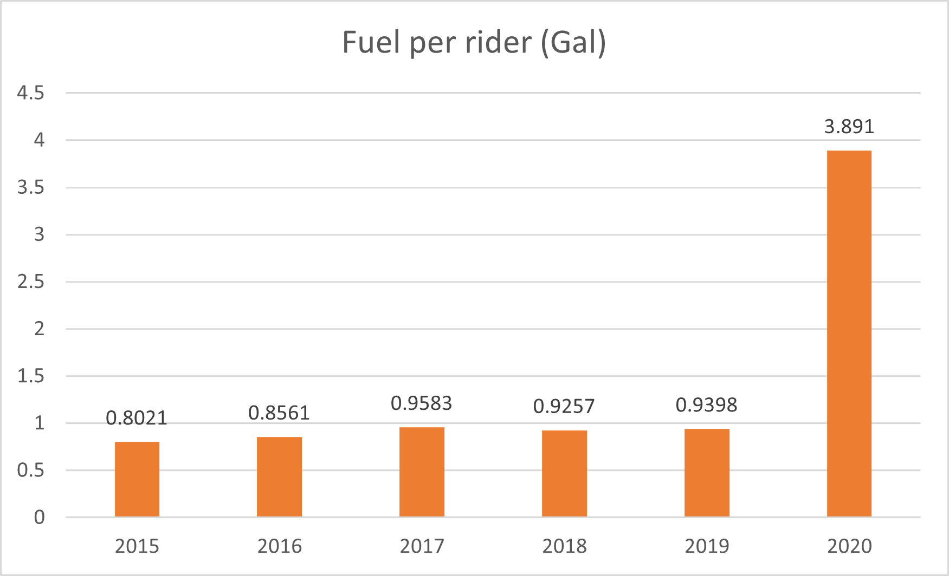
Key Stats
Fuel usage per rider for 2015-2020.

Slide 7
Key Stats

Slide 8
Electricity Usage – 2020
Residential Use
Roughly 50% of people are working from home
Working from home increases residential electricity use by about 4 times as much
Commercial Use
Commercial use buildings are at about 30% capacity

